Slide 1
Inheritance in Java
Presented By S.R.Zameer

Slide 2
Inheritance in Java
Inheritance in java is a mechanism in which one object acquires all the properties and behaviors of parent object.
The idea behind inheritance in java is that you can create new classes that are built upon existing classes. When you inherit from an existing class, you can reuse methods and fields of parent class, and you can add new methods and fields also.
Inheritance represents the IS-A relationship, also known as parent-child relationship.

Slide 3
Why use inheritance in java
For Method Overriding (so runtime polymorphism can be achieved).
For Code Reusability.

Slide 4
Syntax of Java Inheritance
class Subclass-name extends Superclass-name
{
//methods and fields
}
The extends keyword indicates that you are making a new class that derives from an existing class.
In the terminology of Java, a class that is inherited is called a super class. The new class is called a subclass.

Slide 5
Example for inheritance
class Employee
{
float salary=40000;
}
class Programmer extends Employee
{
int bonus=10000;
public static void main(String args[])
{
Programmer p=new Programmer();
System.out.println("Programmer salary is:"+p.salary);
System.out.println("Bonus of Programmer is:"+p.bonus);
}
}

Slide 6
Types of Inheritance in java
On the basis of class, there can be three types of inheritance in java: single, multilevel and hierarchical.
In java programming, multiple and hybrid inheritance is supported through interface only.
We will learn about interfaces later.

Slide 7
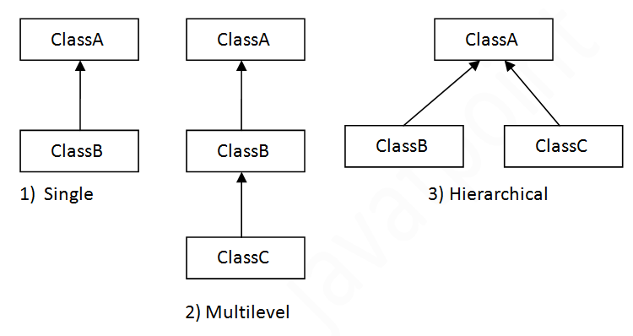
Single Inheritance

Slide 8
Example program
class Faculty
{
float salary=30000;
}
class Science extends Faculty
{
float bonus=2000;
public static void main(String args[])
{
Science obj=new Science();
System.out.println("Salary is:"+obj.salary);
System.out.println("Bonus is:"+obj.bonus);
}
}

Slide 9
Multilevel Inheritance

Slide 10
Example program
class Faculty
{
float total_sal=0, salary=30000;
}
class HRA extends Faculty
{
float hra=3000;
}

Slide 11
class DA extends HRA
{
float da=2000;
}
class Science extends DA
{
float bonus=2000;
public static void main(String args[])
{
Science obj=new Science();
obj.total_sal=obj.salary+obj.hra+obj.da+obj.bonus;
System.out.println("Total Salary is:"+obj.total_sal);
}
}

Slide 12
Hierarchical Inheritance

Slide 13
Example Program
class Common
{
int no;
string name;
}
class student extends common
{
int tfee;
void accept()
{
no=10;
name="rahul";
tfee=5000;
}

Slide 14
void display()
{
System.out.println("\n Student no. :"+no+"\n Student Name :"+name+"\n Total Fee"+tfee);
}
}
class customer extends common
{
int qty;
float price,totbill;
string item;
void accept()
{
no=101;
name="raj";
item="Samsung Key Board";
qty=2;
price=150;
totbill=price*qty;
}

Slide 15
void display()
{
System.out.println("\n Customer no. : "+no+"\n Customer name :"+name+"\n Item purchased :"+Item+"\n Quality :"+qty+"\n Price :"+price+"\n Total Bill :"+totbill);
}
}
class inhervar
{
public static void main(String args[])
{
student s=new Student();
customer c=new Customer();
s.accept();
c.accept();
s.display();
c.display();
}
}

Slide 16
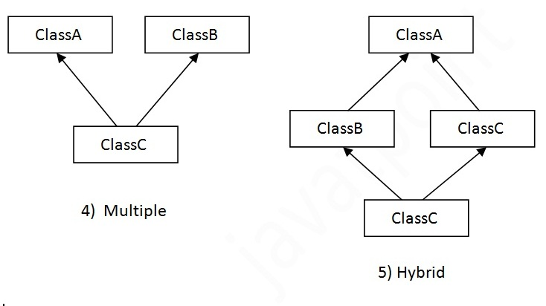
Multiple Inheritance

Slide 17
Hybrid Inheritance

